Slide 1

Cancelling or Deleting Sections
How to Cancel a Section How to Delete a Section

Slide 2
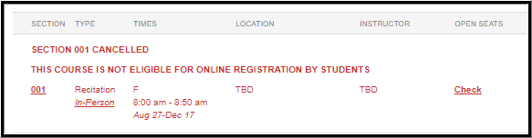
Cancelling versus Deleting a Section – What’s the difference?
Cancelling a Section means the Section will display in the myUK Course Catalog as cancelled. The section is not fully removed and will copy forward to the next like semester (ex. Fall to the next Fall, or Spring to the next Spring)
Deleting a Section means the Section will not be copied forward to the next like semester and will no longer display in the myUK Course Catalog.

Slide 3

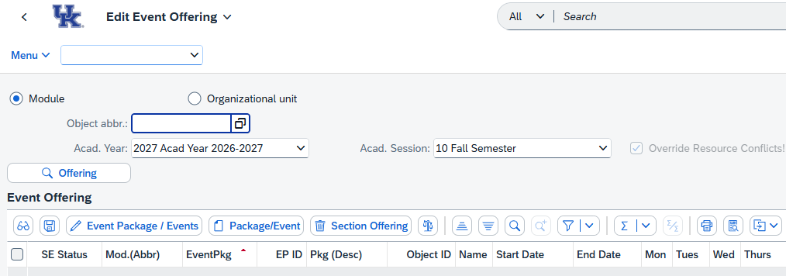
How to: Cancel a Section
Step 1: Open the ZEVPLAN transaction in SAP.
This will bring you to “Screen 1” of ZEVPLAN.

Slide 4
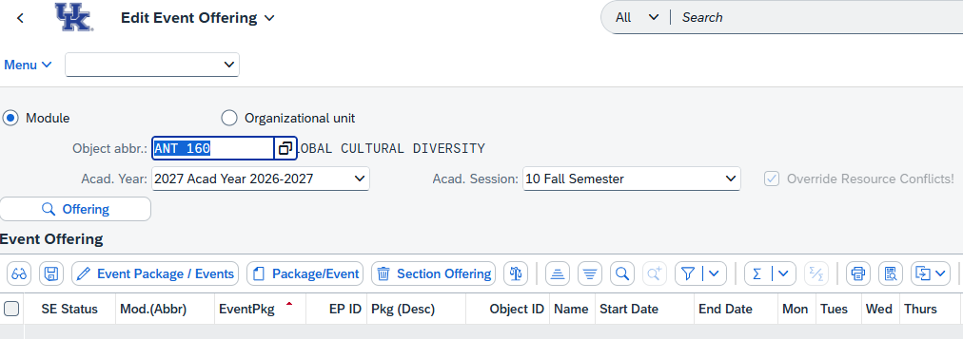
Step 2: Enter the course abbreviation in the “Object abbr.” box, then select the Academic Year and Academic Session (Term) where you’d like to cancel the section.
When finished, click the “Offering” button to load the course.
Note: For course prefixes with only two characters (ex. "FR" or "CE"), you will need to double-space between the prefix and the course number. For example, FR 101 would be entered as "FR 101".

Slide 5
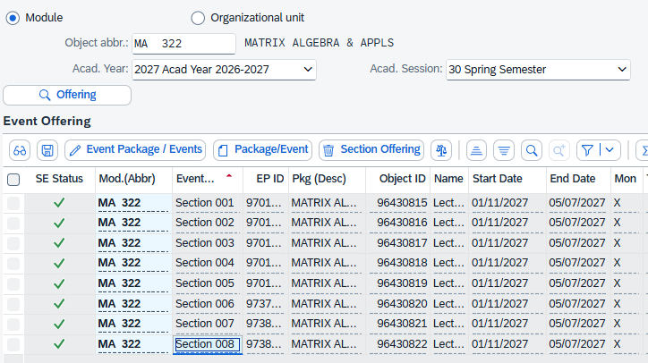
Step 3: Highlight the section you’d like to cancel by clicking anywhere on the line of that section, then click “Edit Event Package/Events”.

Slide 6
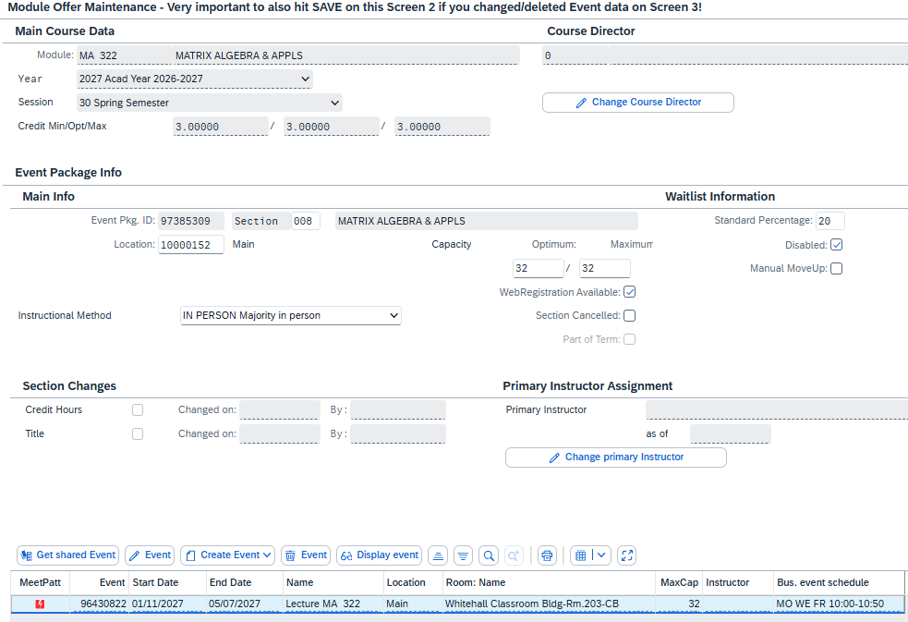
Step 4: If the section has an assignment instructor and/or room, you will need to delete these resources to free them up for use by other sections.
To do this, highlight the Event and click “Edit Event”.

Slide 7
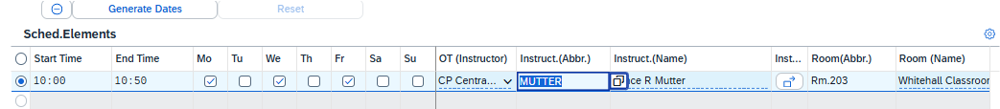

Step 5: Take a screenshot, or make a note of the Start Time, End Time, and days of the week the section was meeting – you will need to be able to fill these details back in.
Highlight the schedule elements line by clicking the radial button at the left, then click “Delete Row”. This will remove the instructor and room from the course and is the only way to delete the room.
Delete Row Button
Radial Button
Fill in the original Start and End time and days of the week, then click “Save” to return to Screen 2.

Slide 8
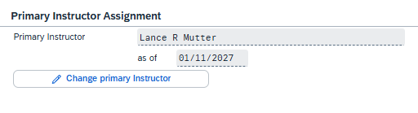
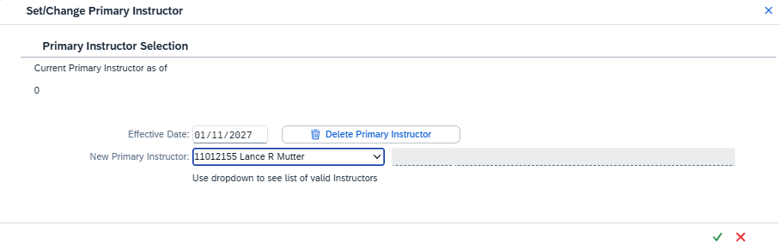
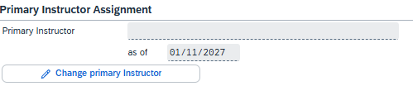
Step 6: On Screen 2, click the “Change Primary Instructor” button, then click “Delete Primary Instructor” and save.
Save Button

Slide 9
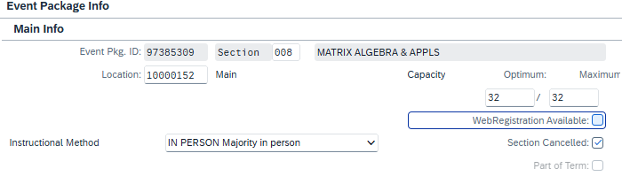
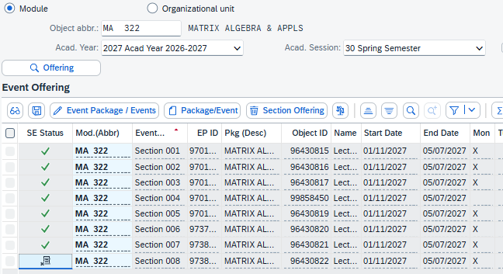
Step 7: Uncheck the “WebRegistration Available” box, then check the “Section Cancelled” box. Click “Save” to return to Screen 1.
The section has now been cancelled.

Slide 10
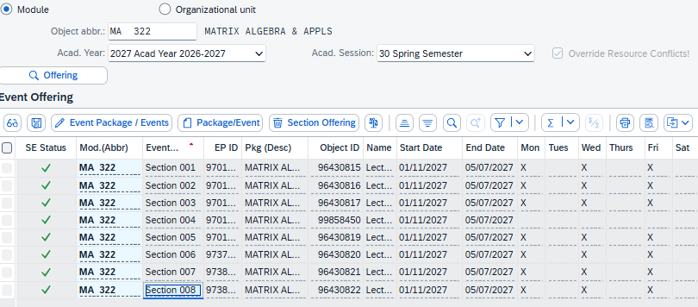
How to: Delete a Section
Step 1: Highlight the section you’d like to delete and click “Edit Event Package/Events”.

Slide 11
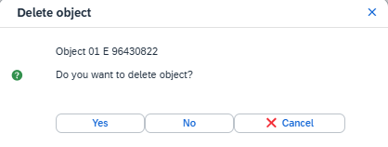

Step 2: Highlight the Event on Screen 2, then click “Delete Event”.
Click “Yes” in the pop-up box.
Once the event has been deleted, click “Save” to return to Screen 1.
Note: It is important to delete the Event before deleting the Section because the Event will still exist in the backend and will sometimes cause issues if not properly deleted.

Slide 12
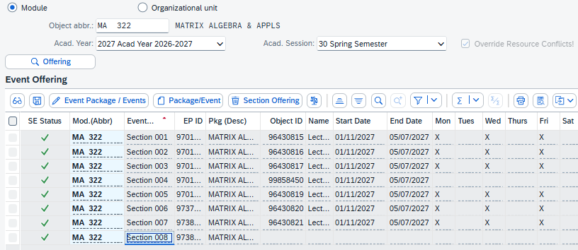
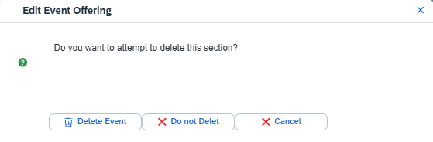
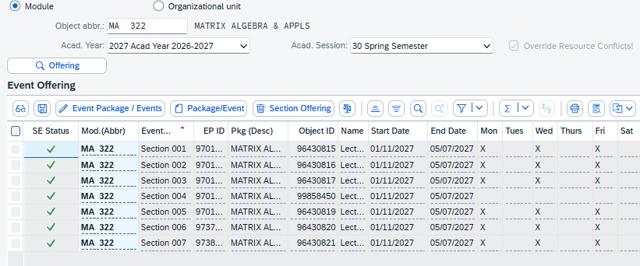
Step 3: Highlight the section on Screen 1, then click “Delete Section Offering”.
Click “Delete Event” in the pop-up box.
The section has now been properly deleted.

Slide 13

Questions?
Contact Course Scheduling at course.scheduling@uky.edu

