Slide 1

Creating a New Section
How to Create a Full-Term or Part-of-Term Section How to Create a Synchronous or Asynchronous Section

Slide 2

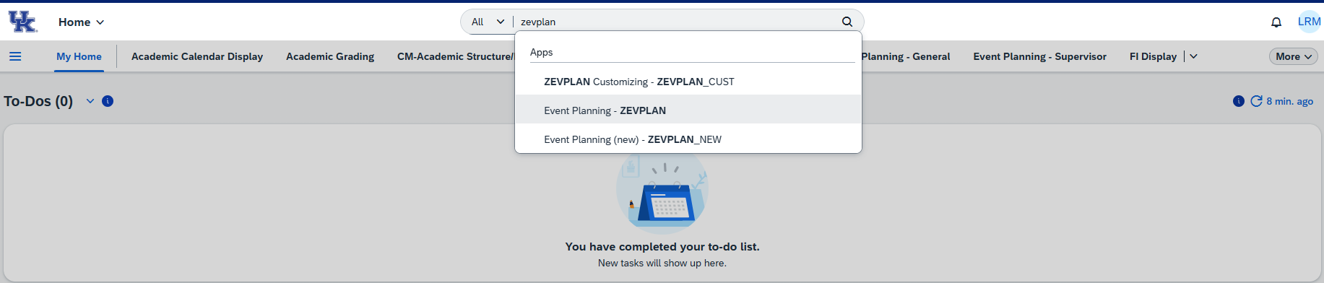
How to: Create a Full-Term Section
Step 1: Open the ZEVPLAN transaction in SAP Fiori.
If you do not have the ZEVPLAN transaction on your SAP Fiori home screen, you can use the search bar at the top to find it. Alternatively, it is also under Event Planning – General in the bar to the left of My Home. Ensure you are using Event Planning – ZEVPLAN and not the other options.

Slide 3
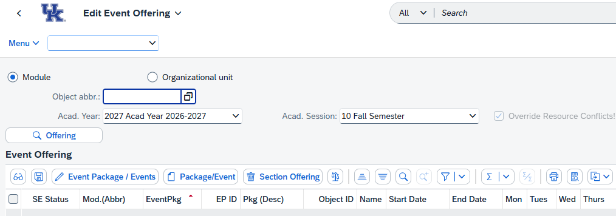
Once you've opened ZEVPLAN, you will be taken to what is known as "Screen 1".

Slide 4
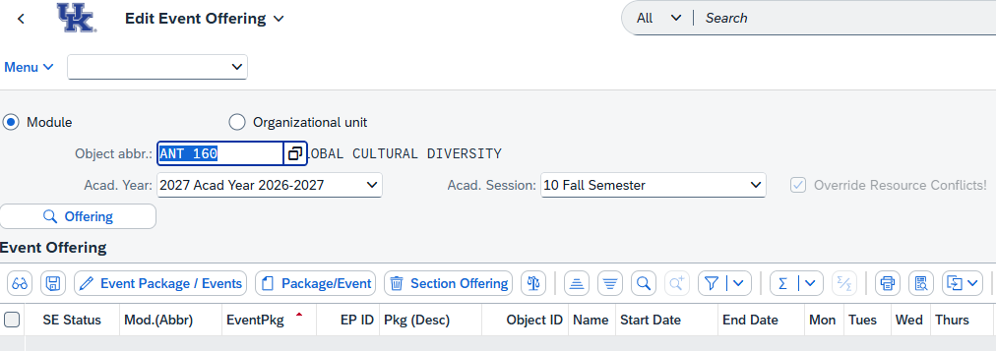
Step 2: Enter the course abbreviation and number in the “Object abbr.” box, then select the Academic Year and Academic Session (Term) where you’d like to create the new section.
When finished, click the “Offering” button to load the course.
Note: For course prefixes with only two characters (ex. "FR" or "CE"), you will need to double-space between the prefix and the course number. For example, FR 101 would be entered as "FR 101".

Slide 5
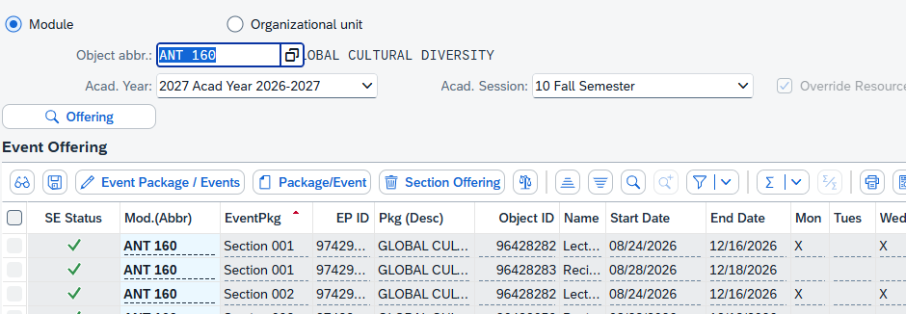
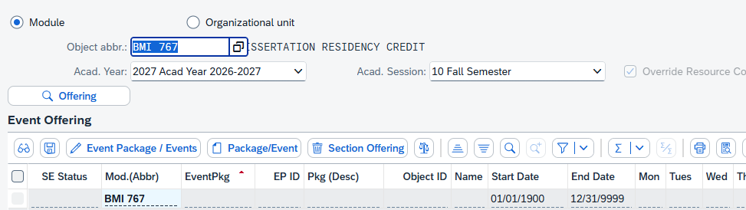
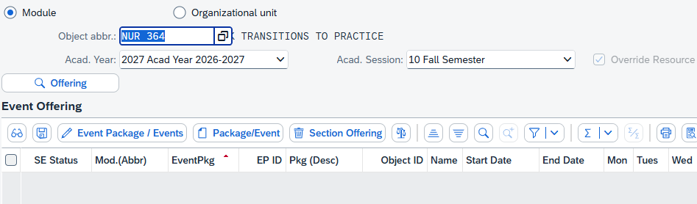
Depending on the course, you may see 3 different displays when loading the course. You may see an existing section or sections, a section shell (meaning not current sections are planned for offering), or a blank course with no sections or shell.
Existing sections: Section shell:
No sections or section shell:
For courses where either existing sections or a section shell exist, you can proceed to Step 3.

Slide 6
If you encounter a course with no existing sections and no section shell, contact Course Scheduling at course.scheduling@uky.edu so that we can check the status of the course.

Slide 7
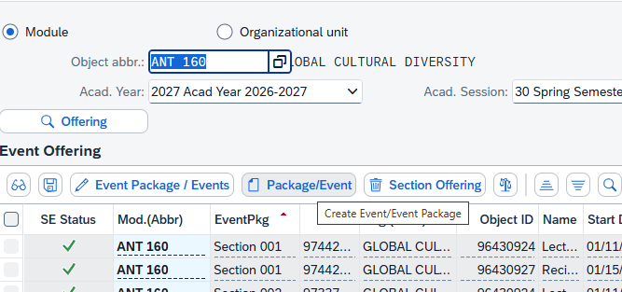
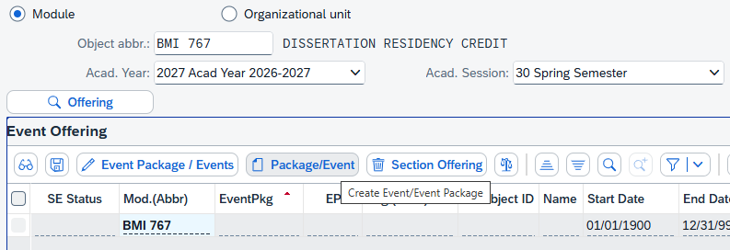
Step 3: To create a new section, click the “Create Package/Event” button.
This will take you to “Screen 2” of ZEVPLAN.

Slide 8
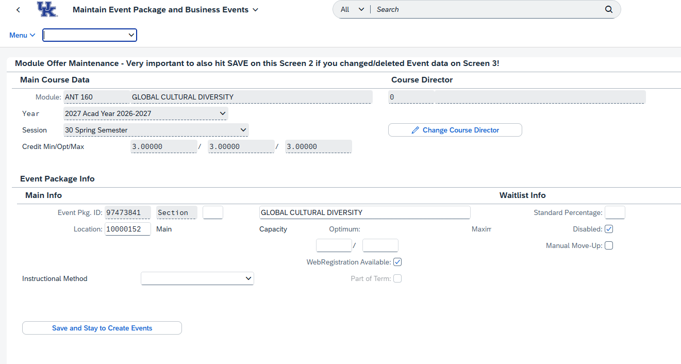
“Screen 2” is the area of ZEVPLAN where you’ll input Section information such as the Section Number, Capacity, Subtitle, Location, and Waitlist.

Slide 9

Step 4: First, enter the Section Number of the new section.
Be sure to follow the appropriate numbering scheme according to the section's modality and location.
Regular, In-person sections should start at Section 001 and follow sequentially (ex. 001, 002, 003, etc.)
Distance Learning sections (whether Fully Online, Hybrid, or Compressed Video/Simulcast) should utilize 200-level section numbers, beginning with Section 201 and continuing sequentially.
Evening/Weekend, Rural Health, and Education Abroad courses should use 400-, 500-, and 700-level section numbers, respectively, and should follow the same sequential pattern. A section that falls under one of these categories and is also Distance Learning should use a section number that corresponds with the Eveneing/Weekend, Rural Health, or Education Abroad designation.
Course Type | Fall Section Numbers | Winter Section Numbers | Spring Section Numbers | Summer Section Numbers
Main Campus | 001-099 | 030-099 | 001-099 | 010-099
Distance Learning | 201-299 | 230-299 | 201-299 | 210-299
Evening/Weekend (17:30 or later) | 401-499 | 430-499 | 401-499 | 410-499
Rural Health | 501-599 | 530-599 | 501-599 | 510-599
Education Abroad | 701-799 | 730-799 | 701-799 | 710-799

Slide 10



Step 5: If the section requires a subtitle, enter the subtitle in the textbox.
Sections that require a subtitle will have some text indicating a subtitle is necessary. For instance, you might see "SR" (subtitle required) or "SUBT" or even "SUBTITLE REQUIRED". If a course is not subtitle approved, the title box will not allow text entry.
All courses titles should be entered in all caps, and a course that does not display "subtitle required" should
not be edited.

Slide 11
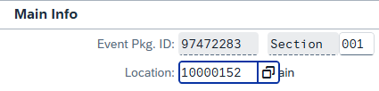
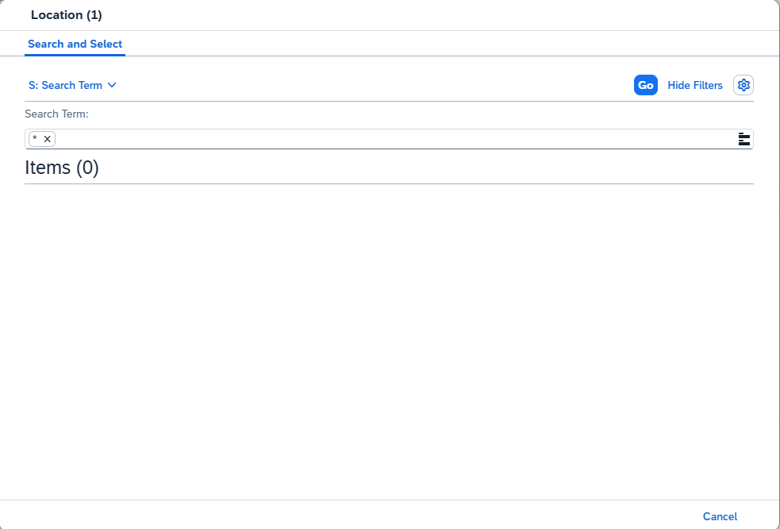

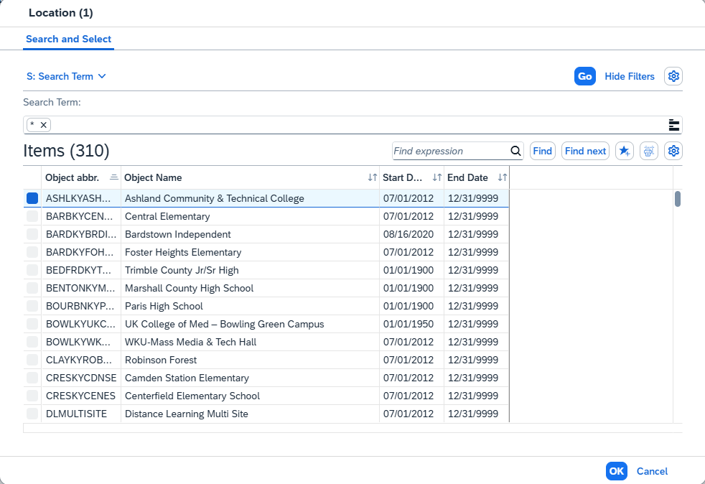
Step 6: If the course is a Distance Learning course (ex. Fully Online, Hybrid, or Compressed Video), you will need to change the Location code to 10548782 – DLMULTISITE. This Location box will also be used for sections that take place at a specific off-campus location, such as a Study Abroad or Independent Study locations.
You can use the search pop-up box to find the correct Location code. Click the search symbol and then hit enter. A list of all locations will appear. Highlight the appropriate line and double-click it to add the selected Location.
Note: All non-US locations are near the bottom of the list as their internal codes begin with ‘Z’
Search Symbol

Slide 12
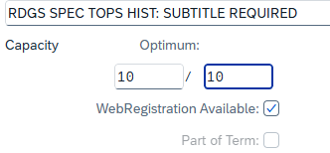
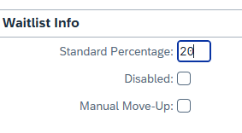
Step 7: Enter the Capacity in the Optimum and Maximum boxes. The number must be the same in both boxes.
If students should be able to register for the course themselves through myUK GPS, make sure the “WebRegistration Available” checkbox is checked.
The Part of Term box is grayed out and will automatically flag based on the start/end dates of the section which we will build later on.
Step 8: If the course will have a waitlist, uncheck the “Disabled” checkbox and enter the percentage in the “Standard Percentage” box. The waitlist is measured by a percentage of the section’s capacity. For example, the default waitlist percentage is 20% of the section’s capacity. If we set the waitlist to 20% for the 10 seats in the step 7 example, a waitlist of 2 seats is created.
Check the “Manual Move-Up” checkbox if the department would like to control the waitlist manually.

Slide 13
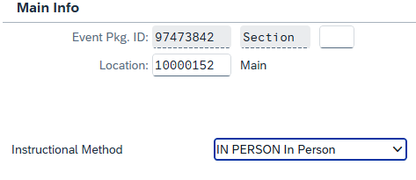
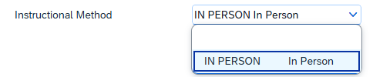
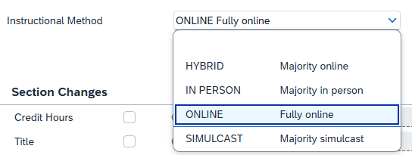
Step 9: Use the drop-down box next to Instructional Method to select the method of instruction for the section. Use the method that best describes how the section will meet.
The options you have in this field depends on if the course has distance learning approval. All courses will have IN PERSON, but only DL approved courses will have the other 3 options.
HYBRID- has both in-person and online events
IN-PERSON- has in-person, on-campus events only
ONLINE- has online events only, synchronous or asynchronous
SIMULCAST- takes place on multiple campuses at the same time. May have multiple event types and instructors
No DL approval
DL Approved

Slide 14
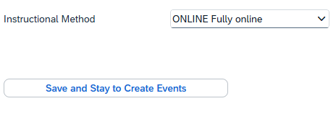
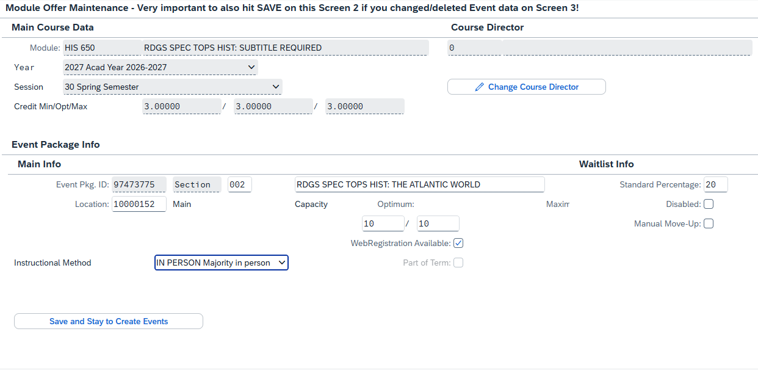
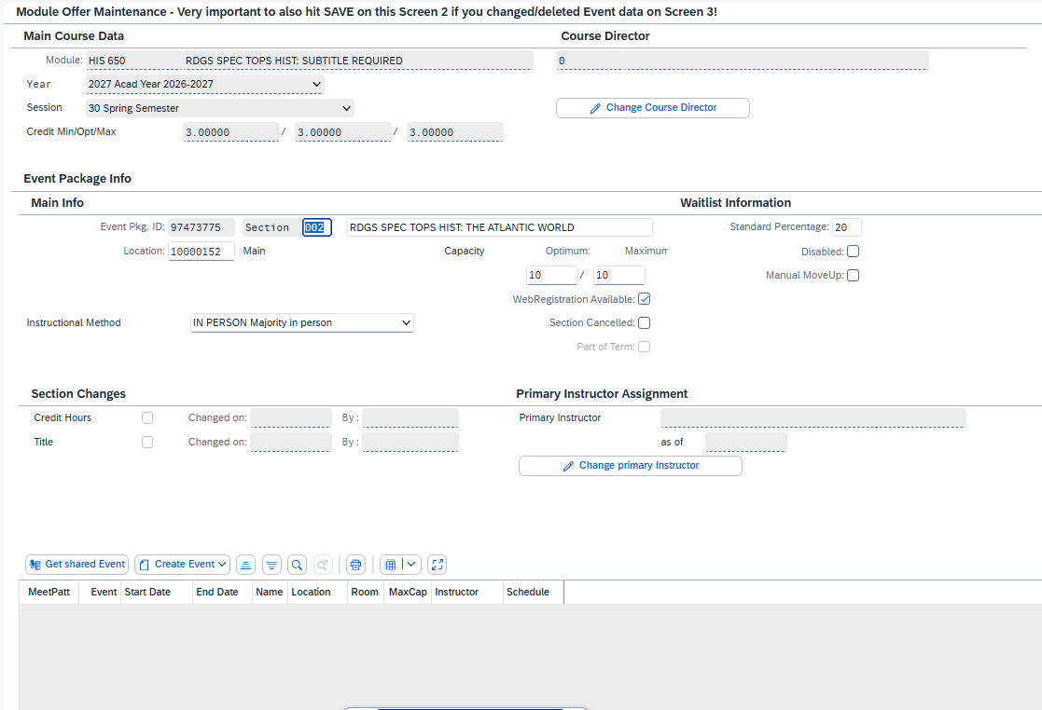
Step 10: Once you have finished putting in the information in on Screen 2, click the ‘Save and Stay to Create Events’ button to save and start building events.
Once Screen 2 has finished saving, you will see several new areas added to it as seen in the pictures below.

Slide 15
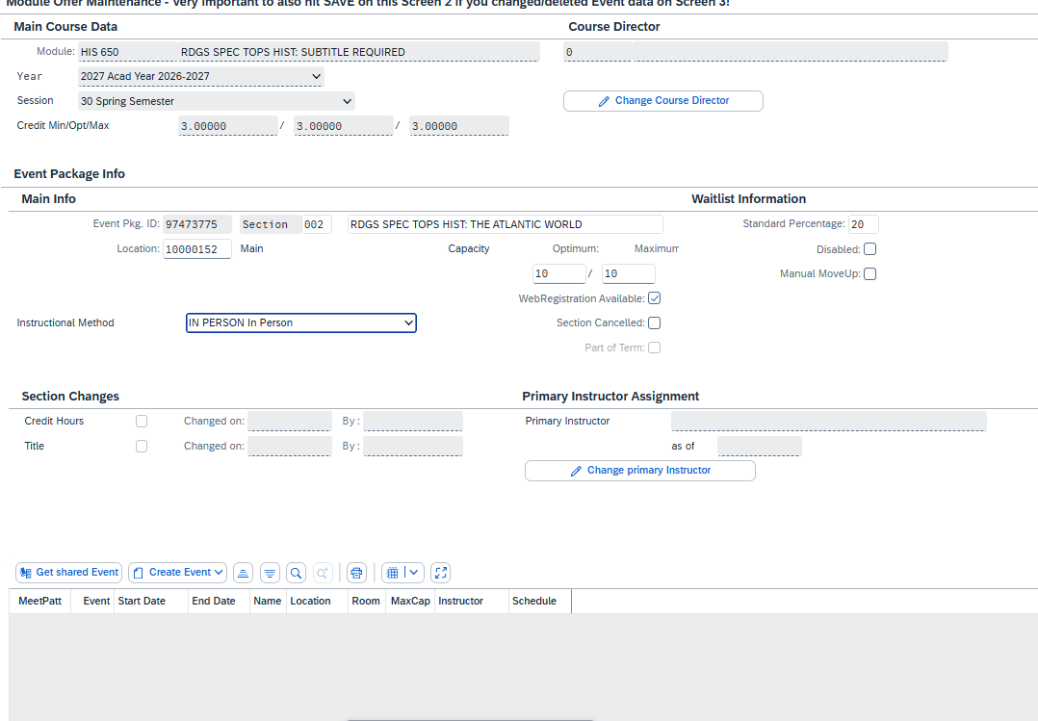
Step 11: To create an event, click the ‘Create Event’ button.

Slide 16
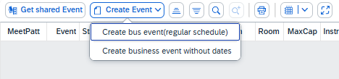
Step 10: Select whether to create a synchronous event pattern with scheduled meeting days and times or an
asynchronous event without any meeting days or times.
Synchronous = “Create bus event (regular schedule)”
Asynchronous = “Create business event without dates”
Note: Depending on your browser, clicking on the ‘Create Event’ button may cause the dropdown to be at the bottom of the screen or cut off. If this happens, just scroll down to the bottom of the Screen 2 and click the button again.

Slide 17
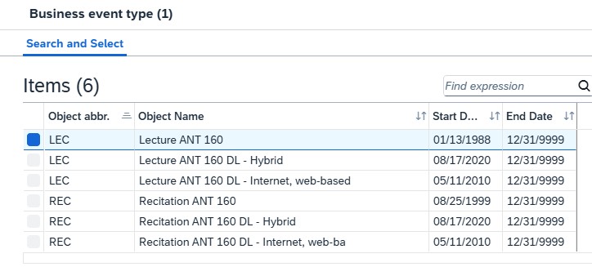
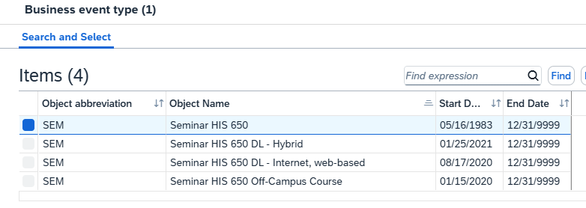
Step 11: If the course has more than one available “event type”, you will then be able to select which event type you’d like to build. Double-click the appropriate option to move on to “Screen 3”.
Some courses have multiple event types like labs, lectures and clinicals
While others only have one event type
Important Information about event types:
Hybrid and Off-Campus event types are being phased out. If you see these, do NOT use them.
Some courses will display ‘DL-Internet, web-based’ as an event type when the course is NOT approved for distance learning. Do not use this event type if the course is not DL approved as it will create issues for students registering for the course and may result in the course being cancelled or in-person. If you need to check DL approval, please use the University Catalog at https://registrar.uky.edu/

Slide 18
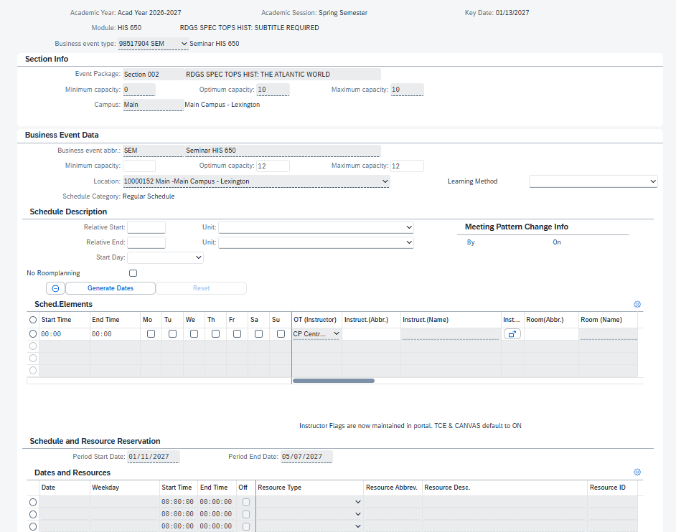
“Screen 3” of ZEVPLAN will allow you create the events that your section will consist of. You can make
changes to the date, time and instructor of the section. You can also add Department Only rooms here.

Slide 19
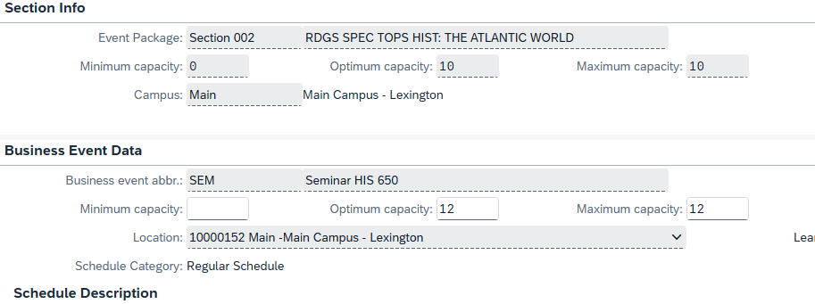
Step 12: Define the Screen 3 capacity for the event. You must enter the same number in both the “Optimum Capacity” and “Maximum Capacity” boxes. Do not enter anything in the “Minimum Capacity” box.
Note: The Screen 3 capacity must be at least the same or higher than the Screen 2 capacity. Entering a higher capacity on Screen 3 will allow you to increase the section capacity later, if needed, through the Course Capacities application in myUK.
However, you will need to make sure the Screen 3 capacity is low enough for to fit the room you’ll assign to the section later (if applicable). For example, any room with a capacity of 12 or more would work for this section, but we would not be able to assign a room that only has 10 seats.

Slide 20
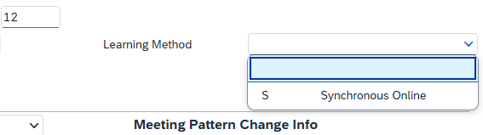
Step 13: If the Event is fully online, you may now select Synchronous Online or Asynchronous Online option as appropriate using the “Learning Method” dropdown menu.
You will only have the option to select Synchronous Online in Synchronous courses and Asynchronous Online in Asynchronous courses.
Note: For events that are not fully online, you will not need to select a Learning Method on Screen 3.

Slide 21
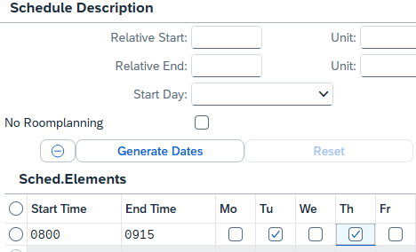
Step 14: If the section is being taught Fully Online or does not require a classroom to be assigned, check the “No Roomplanning” checkbox.
On the “Schedule Elements” line, enter the start and end times and check the appropriate boxes for which days the section will be meeting.
Note: The start and end times use a 24-hour clock. For example, 1pm would be 13:00 and 3pm would be 15:00.

Slide 22


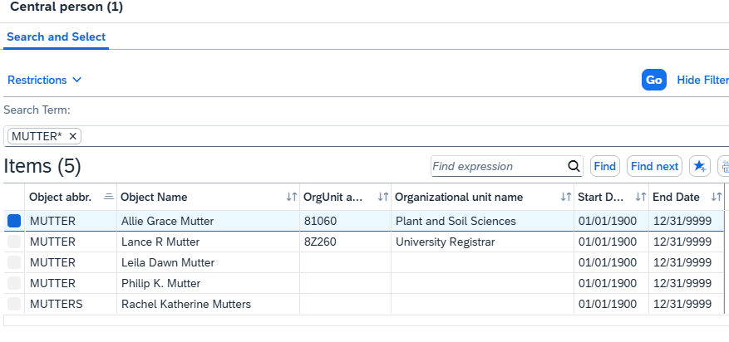

Step 15: You can search by either “first name * last name” or simply by last name. Searching by last name only may yield a large number of results if the instructor has a common last name (ex. Johnson or Smith).

Slide 23
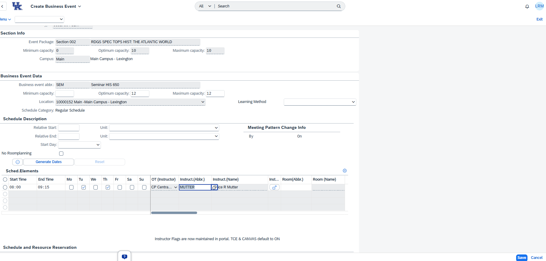
Step 16: Once all information has been entered (except for a room assignment, if applicable), click “Save” to be taken back to Screen 2.
Note: Do not attempt to add a room assignment before completing the Save steps. Adding a room assignment at this point will cause an error that will prevent the room from being assigned correctly to the section and will cause the room to not display in myUK.

Slide 24
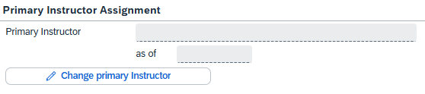
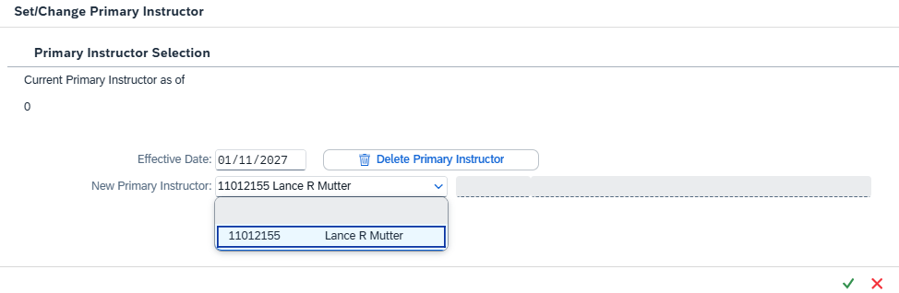
Step 17: Each section is required to have a Primary Instructor Assigned to gain access to Canvas, Class Rolls, Title IV Verification, and to allow students to request accommodations from the DRC.
To assign a Primary Instructor, click the ‘Change Primary Instructor’ button. A pop-up will appear and you
can select the correct instructor from the drop-down. Click the green checkmark to save your choice.
Important Information:
If you do not have any instructor assigned when building the course, you can ignore this step for now.
If you have only one instructor assigned, ZEVPLAN will automatically assign them as Primary Instructor by saving on Screen 2
If you have multiple instructors assigned, then you will not be able to save on Screen 2 until one is selected as Primary Instructor.

Slide 25
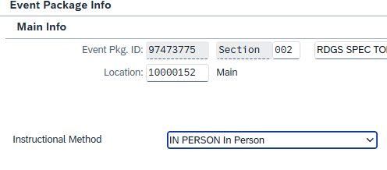
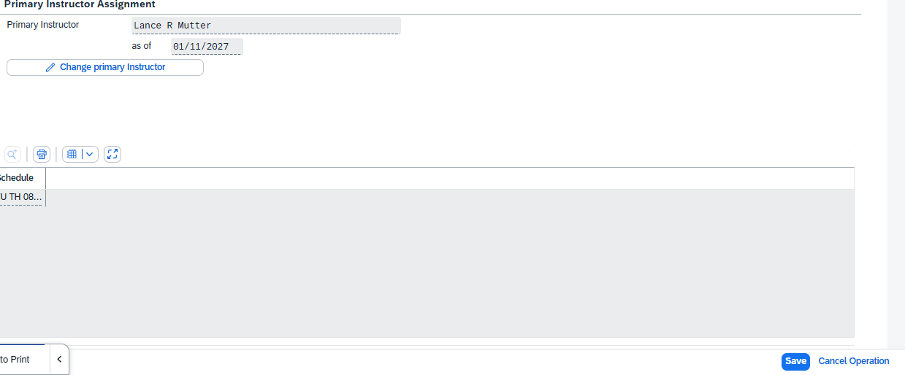
Step 18: Ensure your selection for Instructional Method is still chosen as it will sometimes clear out. You cannot save on Screen 2 until one is selected (see Step 9 for more details).
Step 19: Click the save button in the bottom right corner of the screen to save back to Screen 1.

Slide 26
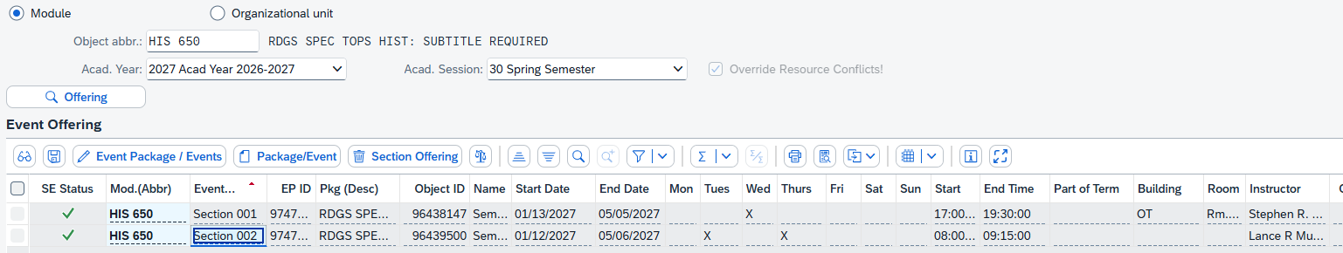
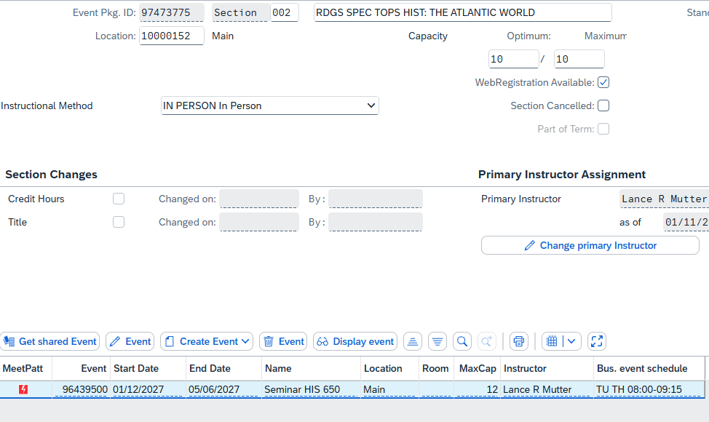
Step 20: If the section is an in-person section that needs a Department Only room assignment, highlight the
section on Screen 1 and click “Edit Event Package/Events”.
Then highlight the Event on Screen 2 and click “Edit Event”.

Slide 27
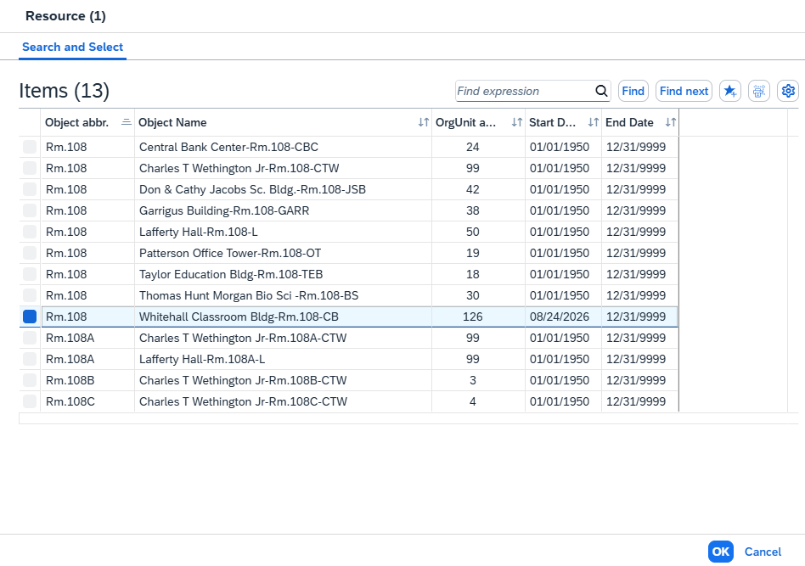
Step 21: Enter the room number in the “Room (Abbr.)” box and hit Enter. All rooms start with “Rm.” and then the
room number with no space in between. Alternatively, you can use “*” followed by the room number to see all
rooms with that number.
Highlight the correct room from the list of options and then double-click to add the room.
Note: You should only assign rooms in which your department has scheduling priority.

Slide 28
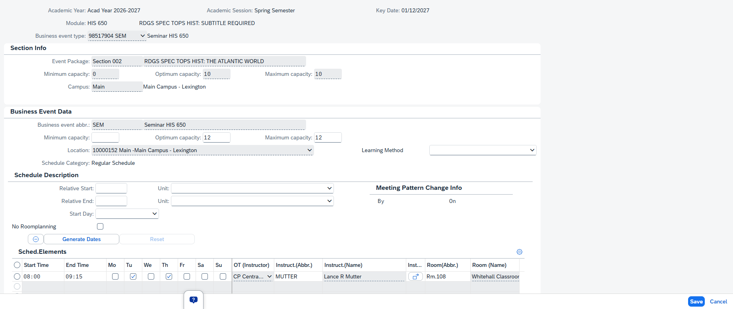
Step 22: Once the room has been added, click “Save” to return to Screen 2.

Slide 29
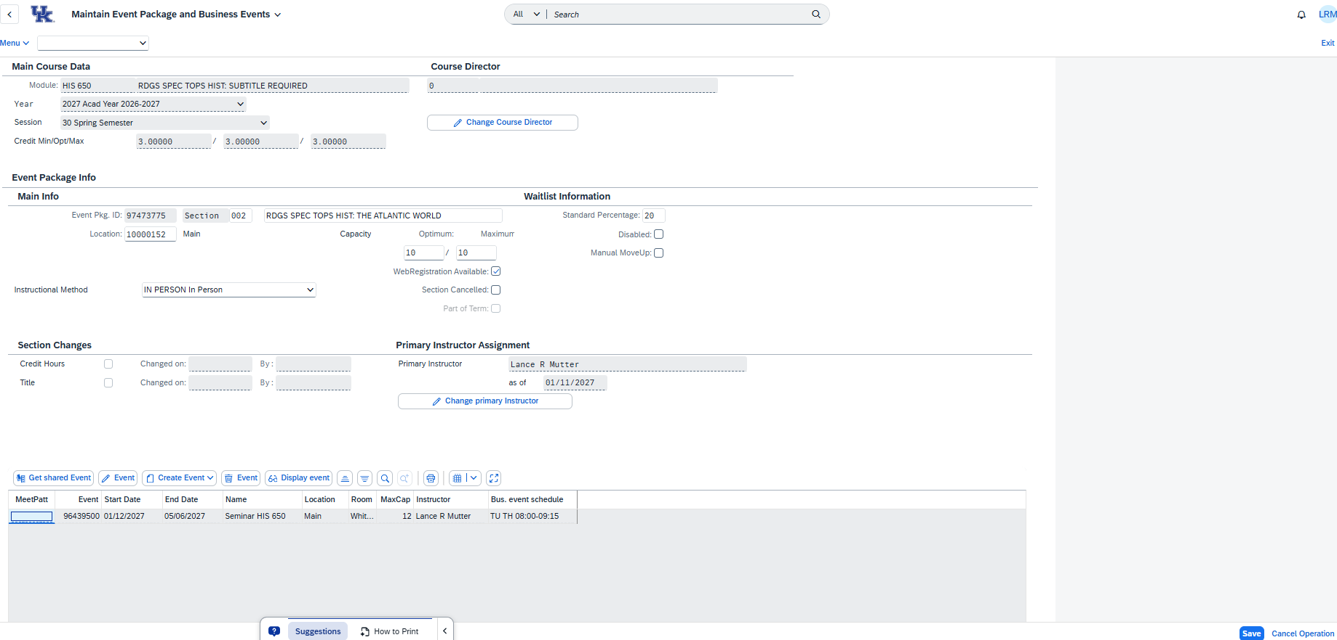
Click “Save” again to return to Screen 1.

Slide 30
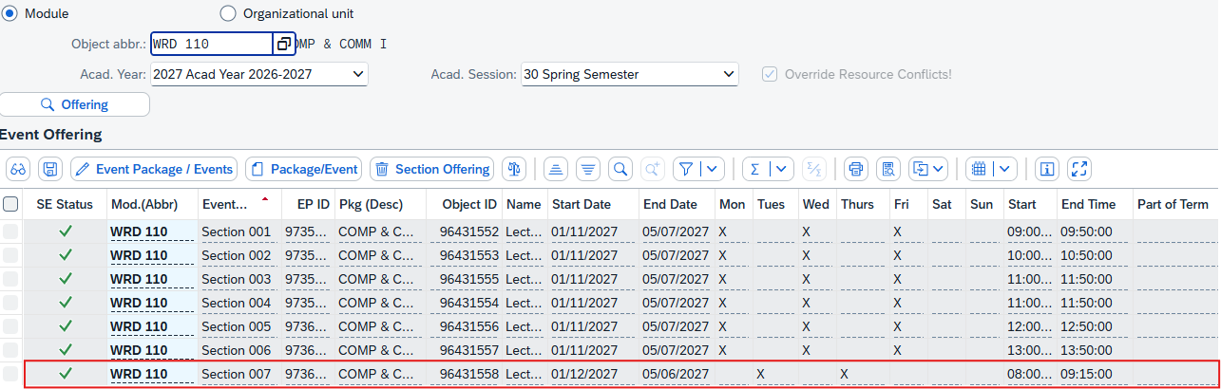
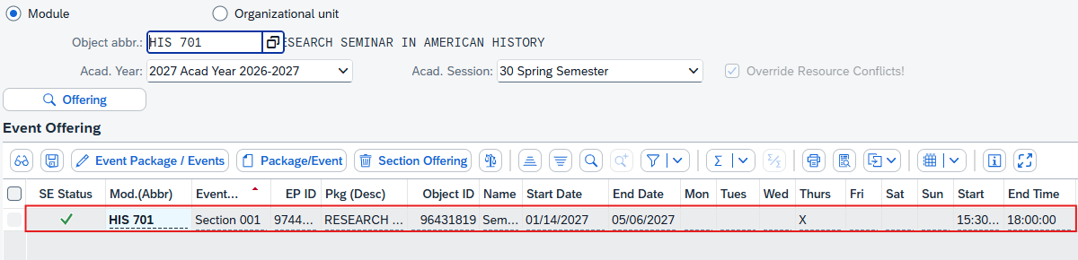
The new section has now been fully created.
Here is what the new section looks like when some sections previously existed:
And here is what the new section will look like if only a section shell existed before:

Slide 31
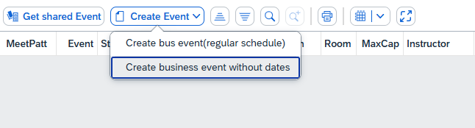
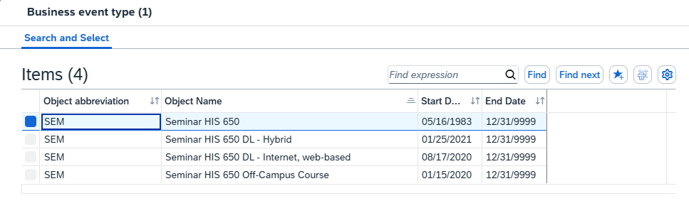
How to: Create an Asynchronous Section
Step 1: Create the section and fill out the Screen 2 information as explained previously. If on Screen 1, highlight the new section and click “Edit Package/Event”. On Screen 2, click “Create Event” and select the second option “Create business event without dates”.
If the course has multiple Event Types to choose from, double-click the appropriate line to select the correct Type/Modality.

Slide 32
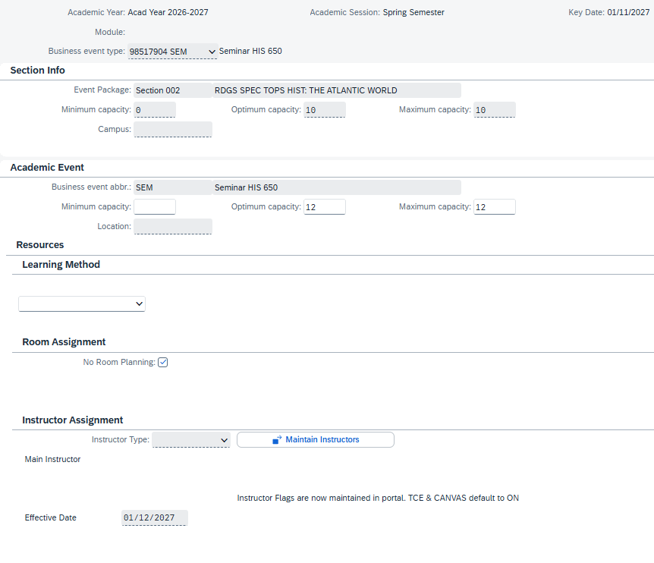
Step 2: Once on Screen 3, you can input the Capacity, Learning Method (Online events only), and Instructor.
When finished, click “Save” to return to Screen 2 and then “Save” again to return to Screen 1.

Slide 33
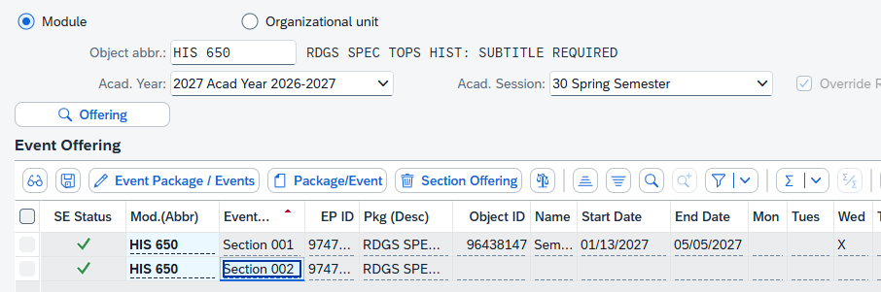
How to: Create a Part-of-Term Section
Step 1: Follow steps 1-10 above to create the Section and input all necessary Screen 2 information. If you are on
Screen 1, highlight the newly created section on Screen 1 and click “Edit Event Package/Events”. Otherwise, skip
to next step.

Slide 34
Step 2: On Screen 2, click the “Create Event” button and then select “Create business event (Regular schedule)”.
Note: You must select “Create business event (regular schedule)” regardless of whether the Section will be
synchronous or asynchronous. This is the only Event Type that allows you to define specific start and end dates.
Step 3: If the course has multiple Event Types to choose from, double-click the appropriate line to select the correct Type/Modality.

Slide 35
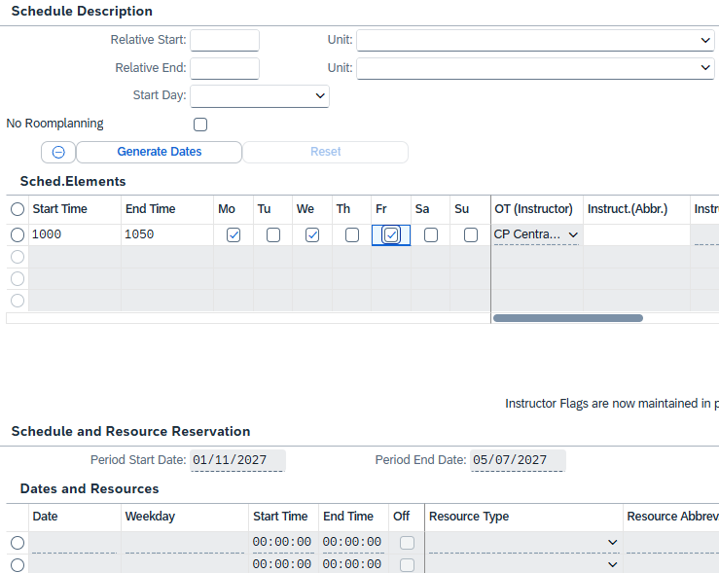
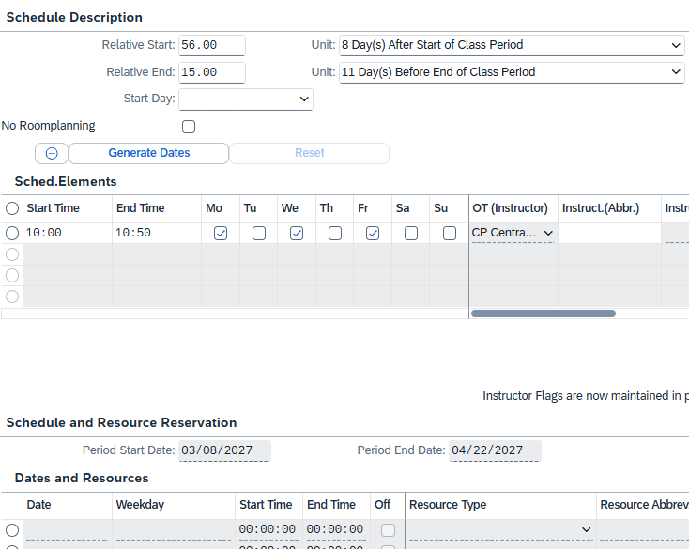
Step 4: On Screen 3, use the “Relative Start” and “Relative End” lines to define specific start and end dates for the section.
The Part of Term Calendar will help you determine how many Days After the Start of the Term or Days Before the End of the Term a specific date is.
For this example, we want to set the start date as 3/8 and the end date as 4/22, so we will set the Relative Start to 56 and select “Day(s) After Start of Class Period” and then set the Relative End to 15 and select “Day(s) Before End of Class Period”.
You can click “Generate Dates” to check that the correct Start and End Dates will result from your inputs.

Slide 36
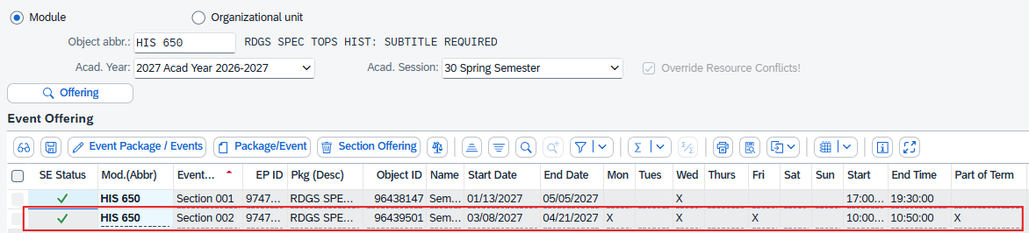
Step 5: Fill out the remaining schedule information (Meeting Times, Days, and Instructor) and then Save back out to Screen 1.
The Part-of-Term section has now been created.

Slide 37
How to: Create an Asynchronous Part-of-Term Section
Step 1: Create the section and fill out the Screen 2 information as explained previously. If you are on Screen 1, highlight the new section and click “Edit Package/Event”. On Screen 2, click “Create Event” and select the first option “Create business event (regular schedule)”.
Note: The “Create business event (regular schedule)” option is the only option that will allow you to input specific start and end dates for a Section. After inputting the specific dates, we will convert the Synchronous Event into an Asynchronous Event. No further changes can be made to the date once the event is saved as asynchronous.

Slide 38
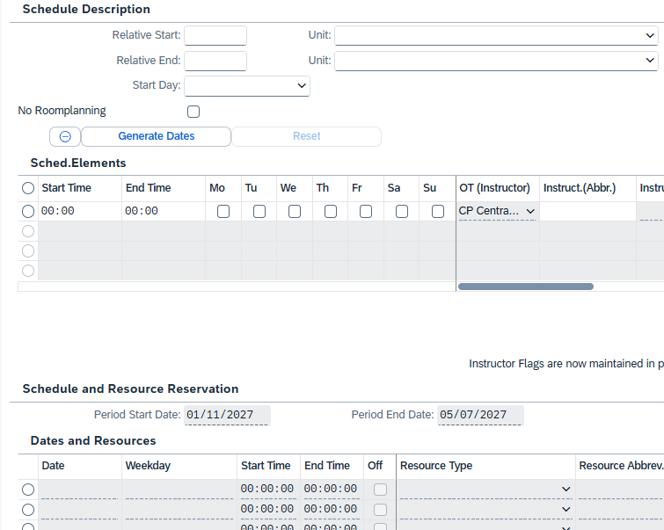
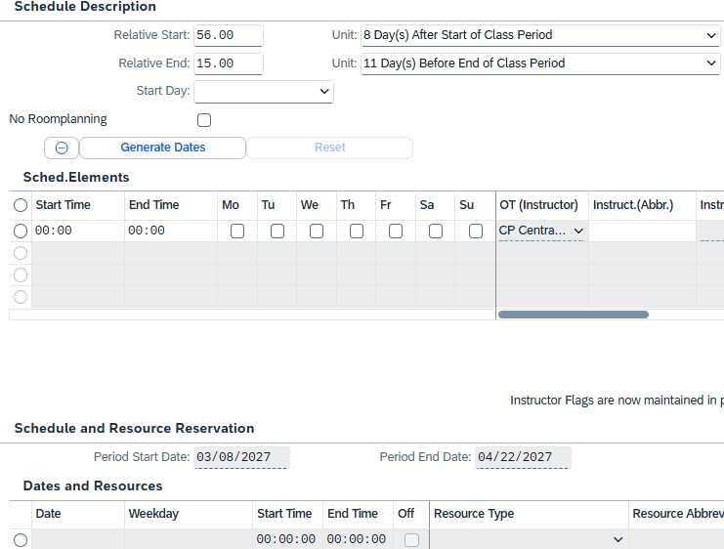
Step 2: On Screen 3, use the “Relative Start” and “Relative End” lines to define specific start and end dates for the section.
The Part of Term Calendar will help you determine how many Days After the Start of the Term or Days Before the End of the Term a specific date is.
For this example, we want to set the start date as 3/8 and the end date as 4/22, so we will set the Relative Start to 56 and select “Day(s) After Start of Class Period” and then set the Relative End to 15 and select “Day(s) Before End of Class Period”.
You can click “Generate Dates” to check that the correct Start and End Dates will result from your inputs.

Slide 39


Step 3: Click “Save” on Screen 3. You will see the below pop-up message – click the checkmark to continue.
You will see a second pop-up message indicating that the Event will be converted into an asynchronous event.
Click the ‘Yes’ to continue.

Slide 40

Step 4: Click “Save” on Screen 2 to return to Screen 1. The Section has now been set up with the specific dates that were entered on Screen 3.

Slide 41
Questions?
Contact Course Scheduling at course.scheduling@uky.edu

