Slide 1

Editing a Section
How to Change a Meeting Pattern How to Change an Event Type or Modality

Slide 2

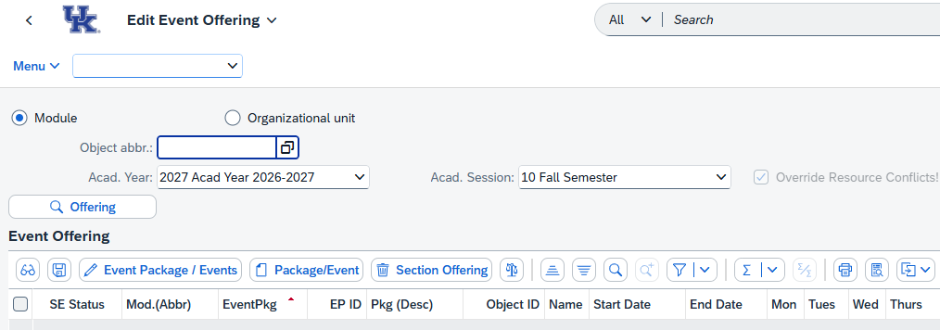
How to: Edit Existing Section Information
Step 1: Open the ZEVPLAN transaction in SAP.
This will bring you to “Screen 1” of ZEVPLAN.

Slide 3
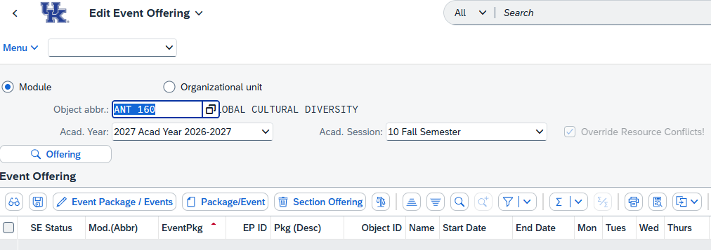
Step 2: Enter the course abbreviation in the “Object abbr.” box, then select the appropriate Academic Year and Academic Session (Term) of the Section you’d like to edit.
When finished, click the “Offering” button to load the course.
Note: For course prefixes with only two characters (ex. "FR" or "CE"), you will need to double-space between the prefix and the course number. For example, FR 101 would be entered as "FR 101".

Slide 4
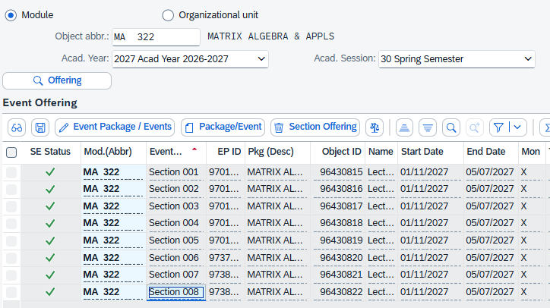
Step 3: Highlight the section by clicking anywhere on its line and then click “Edit Event Package/Events”.
This will take you to Screen 2 of ZEVPLAN.

Slide 5
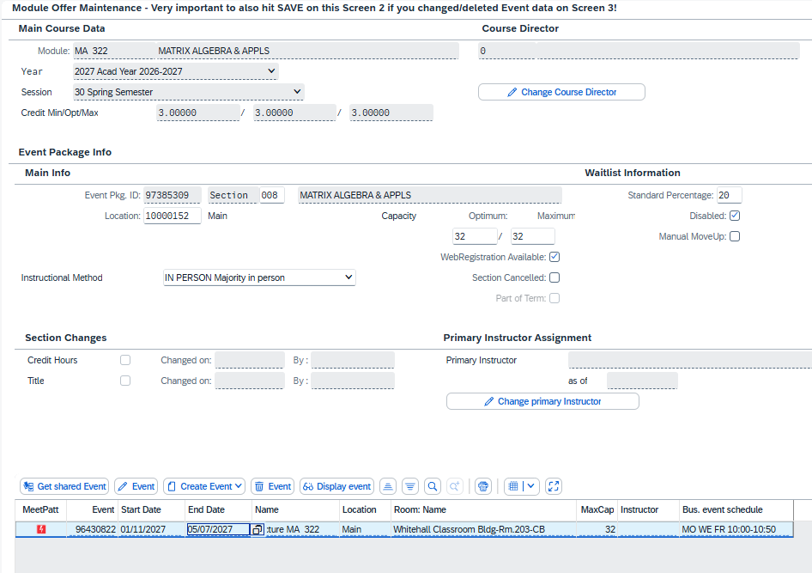
Step 4: On Screen 2 you can edit Section information including the Location code, Subtitle (if applicable), Capacity, Credit Hours (if variable credit), Waitlist, or Primary Instructor.
Once finished editing on Screen 2, click “Save” to return to Screen 1.
If you do not need to edit any information on Screen 2 and instead need to edit Screen 3 information, click “Edit Event”.
Edit Screen 3
Note: Both the Optimum and Maximum capacities must be edited to reflect the same number.
If a section's title is changed (for Subtitle Required courses), the title should be entered in all caps.
Ensure the correct Instructional Method is labelled before moving on.

Slide 6
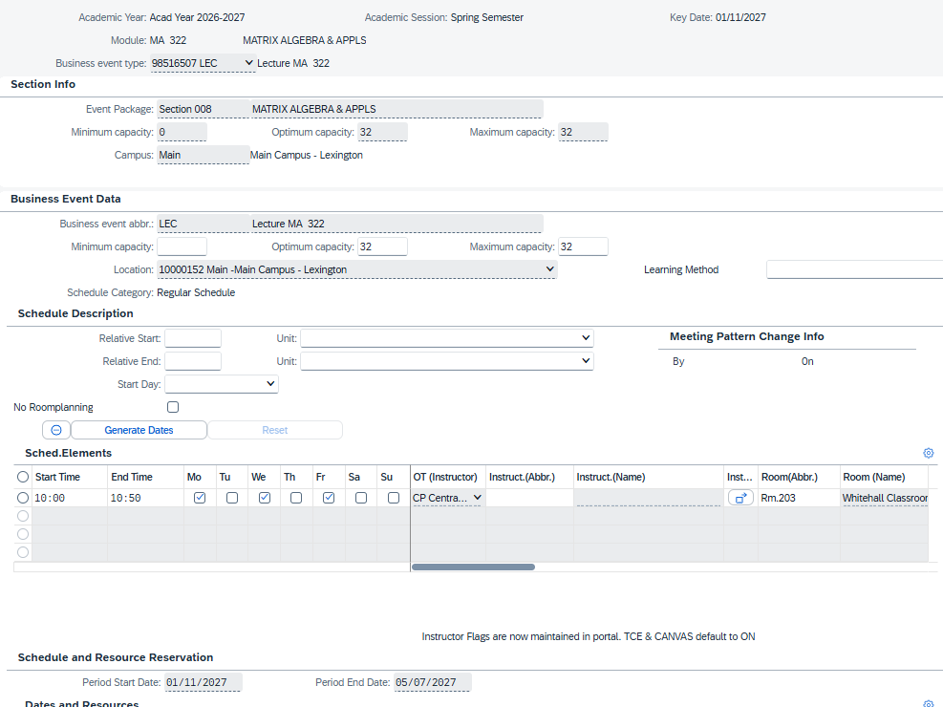
Step 5: On Screen 3, you can edit Event information including the Maximum Capacity, Learning Method, Start and End Dates (for part-of-term sections), meeting Start and End Times, Meeting Days, Instructors, and Room Assignments.
Once finished, click “Save” to return to Screen 2, then click “Save” again to return to Screen 1.
Note: Both the Optimum and Maximum capacities must be edited to reflect the same number.
Changing the Instructor on Screen 3 will only update the Primary Instructor if they are the only instructor assigned to the section. If multiple instructors are on the section, then you will need to choose one for Primary Instructor before saving on Screen 2.

Slide 7
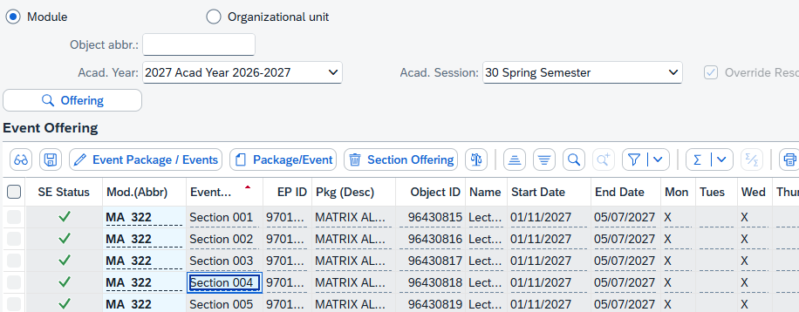
How to: Change a Section from a Synchronous Event to an Asynchronous Event, or vice versa
Step 1: Highlight the section by clicking anywhere on the line and then click “Edit Event Package/Events”.
This will take you to Screen 2 of ZEVPLAN.

Slide 8
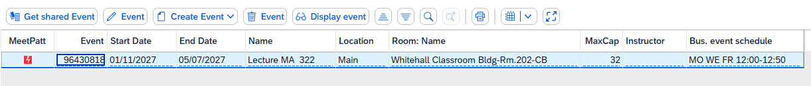
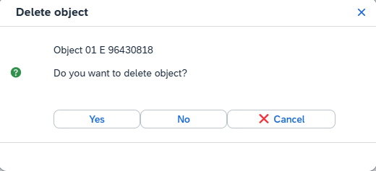
Step 2: To change from a synchronous event to an asynchronous event (or vise versa), you will need to delete the existing event and create a new one.
For this example, we will be replacing a synchronous event with an asynchronous event. Click “Delete Event” to delete the existing Event.
Then click “Yes” in the pop-up box.
Note: Ensure you are in Screen 2 before deleting any items.
Deleting an item on Screen 2 isn’t permanent until you save on Screen 2. If you delete the wrong event, you can use the ‘Cancel Operation’ button in the right-hand corner next to ‘Save’ to restore the deleted event.

Slide 9
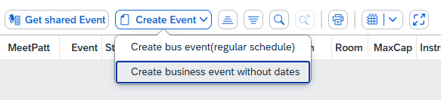
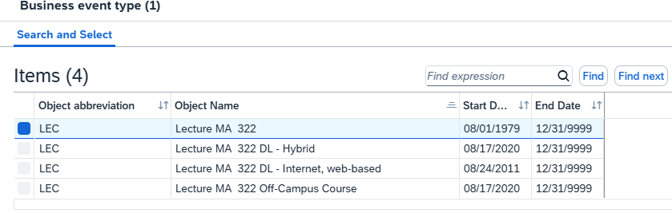
Step 3: Once the original Event has been deleted, click “Create Event” and choose “Create business event without dates” to create an asynchronous event.
If necessary, select the correct Event Type and/or modality from the pop-up window.

Slide 10
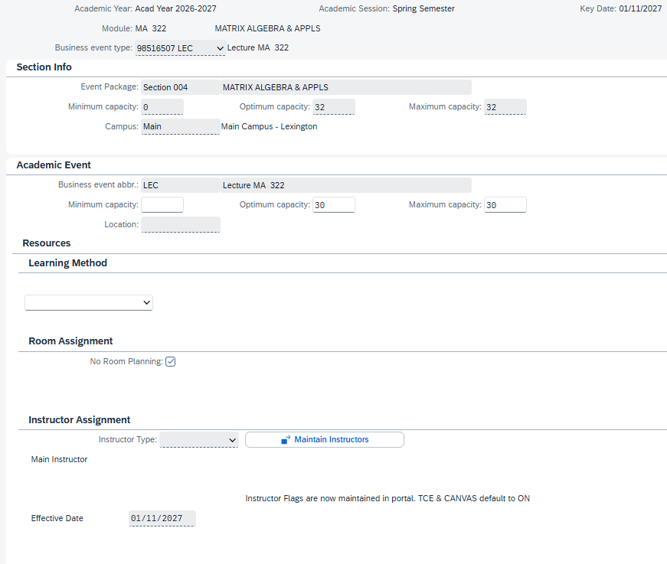
Step 4: Fill out all necessary information on Screen 3, then click “Save”. Click “Save” again on Screen 2 to return to Screen 1.

Slide 11
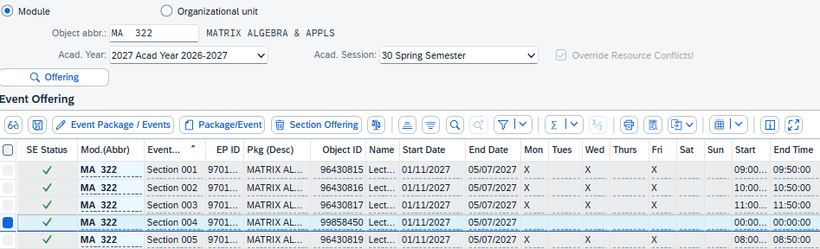
Step 5: The original synchronous event has now been replaced with an asynchronous event.
NOTE: This same method can be used to change the meeting's modality (ex. from In-person to Fully Online) of an existing Section.

Slide 12

Questions?
Contact Course Scheduling at course.scheduling@uky.edu

